Slide 1
King County Housing Prices
Module 1 final Project
Krystian Dennis 12 August 2019

Slide 2

Contact Information
Krystian Dennis
krystiandennis@gmail.com
Jupyter Notebook and Presentation can be found at:
https://github.com/krystiandennis/mod1-final-project

Slide 3
Outline
Outline
1 - Objectives and Dataset
2 - Initial Observations
3 - Cleaning the Data
4 - Preparing Data for Analysis
5 - Data Model
6 - Model Results
7 - Recommendations

Slide 4
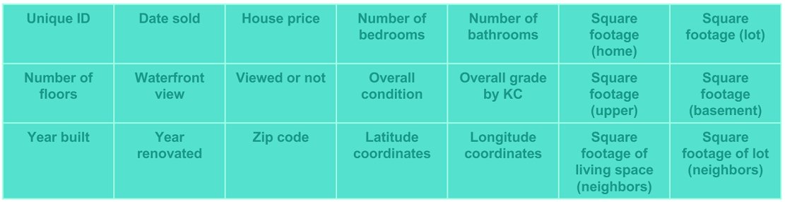
Objective and Data Set
The King County House Price Dataset contained records of over 21,000 home sales the Seattle area from Sept 2014-Sept 2015
The dataset included 19 variables ranging from number of bathrooms to square footage of the basement
The objective was to use these variables to create a model capable of predicting the sales price of similar properties in the area

Slide 5
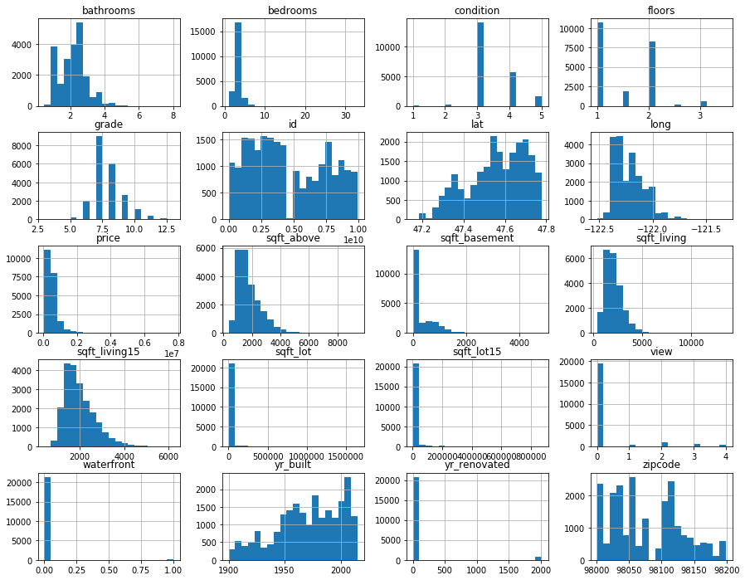
Initial Observations
The dataset contains categorical (like bedrooms) and continuous variable (like sqft_lot)
The data appears skewed for variables like sqft_above
There appears to be missing data for variables like yr_renovated

Slide 6
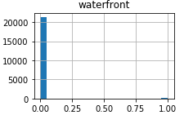
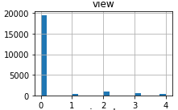
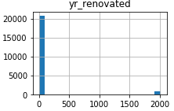
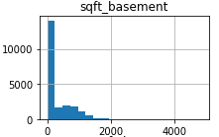
Cleaning The Data
Three variables were missing values
‘waterfront’ was missing 11% of values
Replaced with ‘0’
‘view’ was missing 0.2% of values
Replaced with ‘0’
‘yr_renovated missing 18% of values
Replaced with ‘0’
One variables contained placeholders
‘sqft_basement’ contained 2% of ‘?’
Replaced with ‘0’

Slide 7
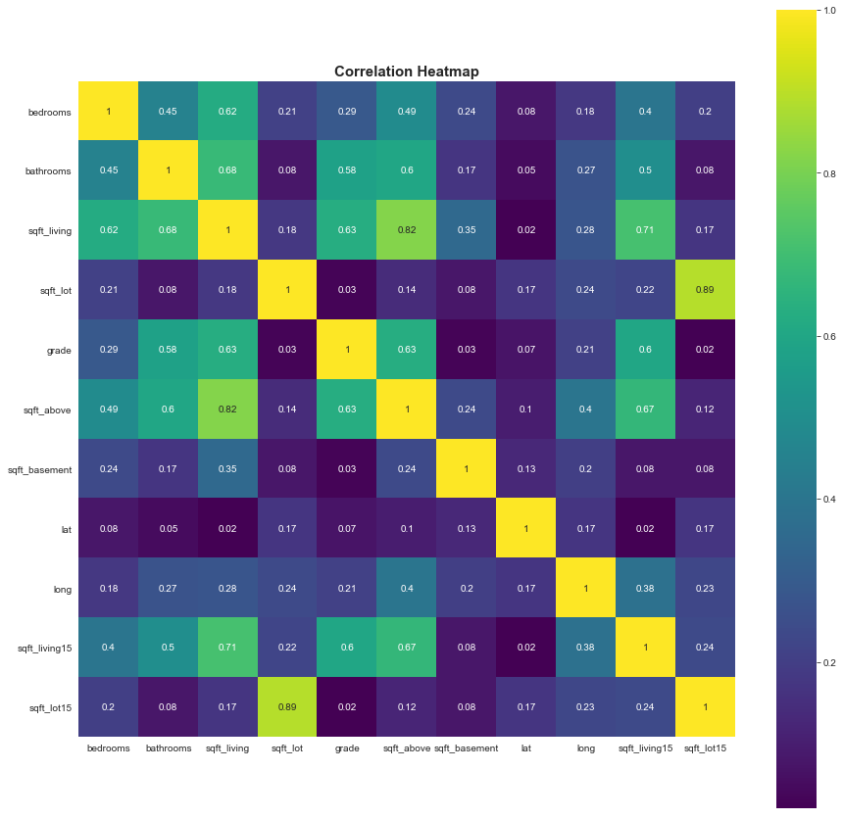
Preparing Data for Analysis
Variables not demonstrating linear relationship with ‘price’ removed from dataset
Outliers removed from dataset
IQR*1.5
All variables min-max scaled
Continuous variables log transformed
Independent variables with high correlation to each other removed from dataset

Slide 8
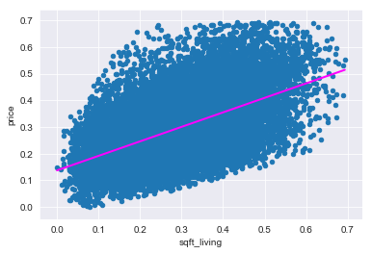
Data Model
Simple Linear Regression used on continuous variable to determine inclusion in model
r-squared above 0.2
p-value below 0.05
Recursive Feature Elimination used to construct model
2 variables
4 variables
All variables
Performance of model evaluated using linear regression

Slide 9
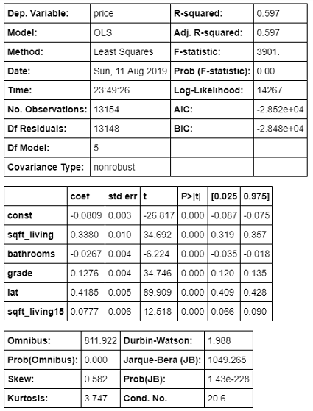
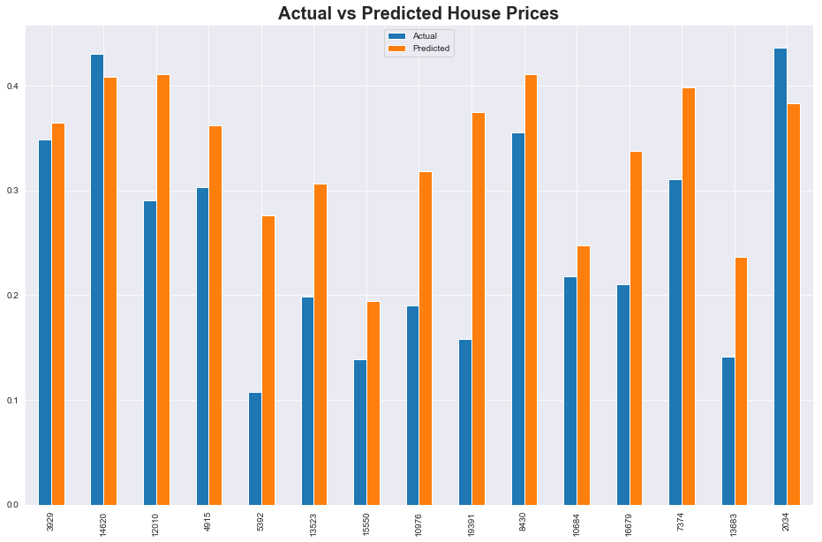
Model Results
Approximately 60% of variation in house prices can be explained by the model
Model cross-validated with only -0.03 difference of MSE between actual and predicted house prices.

Slide 10
Conclusion
Up 60% of the variation in house prices can be explained by the model
‘sqft_living’ and ‘lat’ influence house prices most strongly
Model tends to predict a higher house price than the actual house prices
To improve model, more variables will be included in model

